Slide 1
Factory Method
Factory Method is widely used.
It appears in almost all Java frameworks.
A simple factory method (not really the pattern) is also very useful for simplifying object creation.
For example:
Calendar cal = Calendar.newInstance( );
The explanation of Factory method is given in separate doc file.

Slide 2
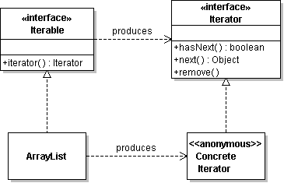
Iterator.iterator( ) is Factory method
How to create iterators?
We don't want the application to know the logic for creating different kinds of iterators.

Slide 3
Factory Method
Factory Interface | Iterable
Factory Method | iterator( )
Product | Iterator
Concrete Product | class implementing Iterator

